Slide 1
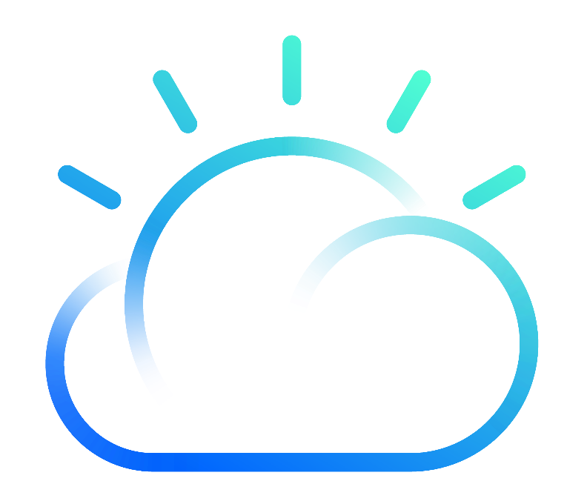
App Connect Enterprise Containers
Notes:
Deploying and managing integrations across private and third-party clouds with App Connect Enterprise Containers

Slide 2
Docker Image Options for ACE and MQ
Docker Image
Docker Image
Docker Image
Integration Server
Integration Server
Integration Server
MQ Client
Local Queue Manager
MQ connectivity | Yes (HTTP API) | Yes (client binding) | Yes (server binding)
1PC for MQ | No | Yes | Yes
EDA nodes | No | No | Yes
2PC | No | No | Yes
Horizontally scalable | Yes | Yes | Yes (with loss of sequencing)
Persistent volume | Not required | Not required | Required (if durability desired)
Start up | Fast | Fast | Slower
Disk space | Smallest | Medium | Largest
2

Slide 3
Same ACE/MQ image
…but different configuration and usage
ReplicaSet “replicas=n”
StatefulSet “replicas=1”
Kubernetes Pod
Kubernetes Pod
Docker Container
Docker Container
Integration Server
Integration Server
Persistent
Volume
Local Queue Manager
Local Queue Manager
replicas = n
no persistent volume claim
HA by replication (continuous availability)
Elastic horizontally scalability
Non-durable use of EDA nodes
No 2 Phase Commit
replicas = 1
persistent volume claim
HA by reinstatement
Manual horizontal scalability
Durable use of EDA nodes
2 Phase Commit

Slide 4
Scalable
no MQ Client
Scalable
with MQ Client
Scalable, with non-persistent local MQ
Single instance with persistent local MQ
Active/active with persistent independent local MQ
Traditional
(with node)
RS “=n”
RS “=n”
RS “=n”
SS “=1”
SS “=1”
Pod
Pod
Pod
Pod
Pod
Shown separately
Cont.
Cont.
Cont.
Cont.
Cont.
IS
IS
IS
IS
IS
MQ Client
QM
QM
QM
PV
PV
Stateless | Stateless | Stateless | Stateful | Stateful | Stateful
Continuous availability | Continuous availability | Continuous availability | High Availability | Continuous Service Availability High Message Availability | Continuous Availability
Dynamic horizontal scaling | Dynamic horizontal scaling | Dynamic horizontal scaling | Vertical scaling only | Non-dynamic horizontal scaling | Non-dynamic horizontal scaling
No EDA | No EDA | Enables EDA, but note that must be replica=1 for sequencing | Enables EDA and 2PC | Enables EDA and 2PC | Enables EDA and 2PC
Cattle
Pets

Slide 5
Containers and pods for ACE and MQ
Pod
Pod
Pod
Container
Container
Container
Integration Server
Integration Server
Integration Server
“server” connection
(IPC)
“server”
connection
(IPC)
“client” connection
(TCP/IP)
Queue Manager
Container
Pod
Queue Manager
Requires combined ACE/MQ image – not ideal from container design point of view. Prefer to only have one core purpose/process per container.
Enables event nodes
Enables 2PC (MQ, ODBC, JMS, JDBC, CICS)
Ties topology of ACE and MQ together.
Container
Queue Manager
Standard ACE and MQ images can be used
Enables event nodes
Enables 2PC (MQ, ODBC)
Requires Docker 1.12 or later and Kubernetes 1.10 (alpha feature)
Standard ACE and MQ containers can be used
Does not enable event nodes
Does not enable 2PC
TCP/IP = Network based inter-communication
IPC = Inter Process Communication (via shared memory)

Slide 6

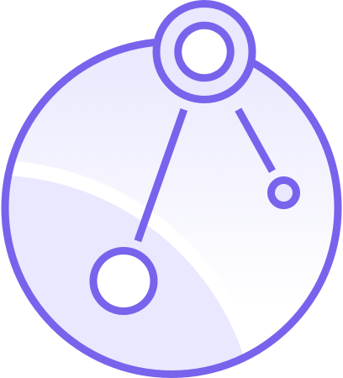
(The current generation of …)
App Connect Enterprise on IBM Cloud Private

Slide 7
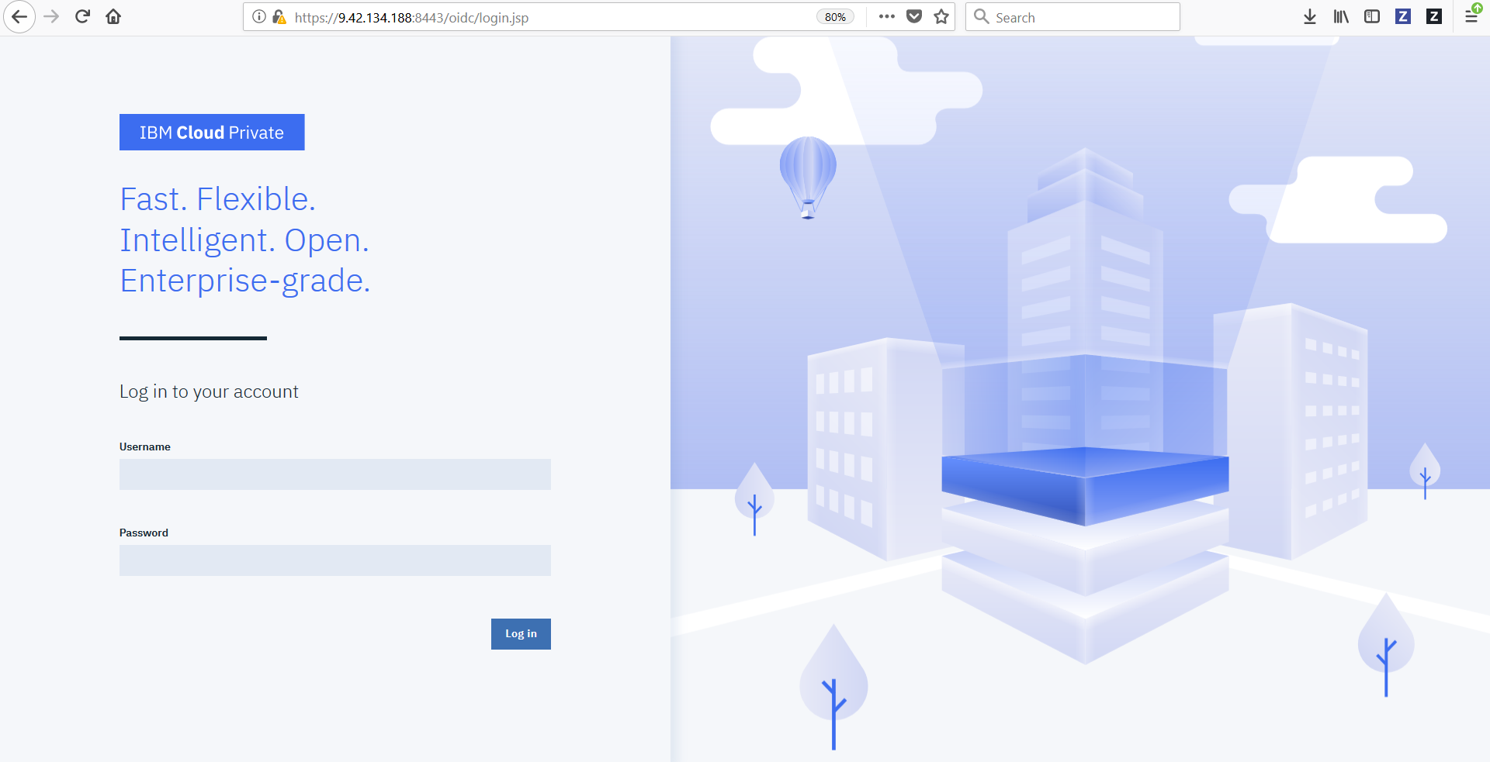

Slide 8
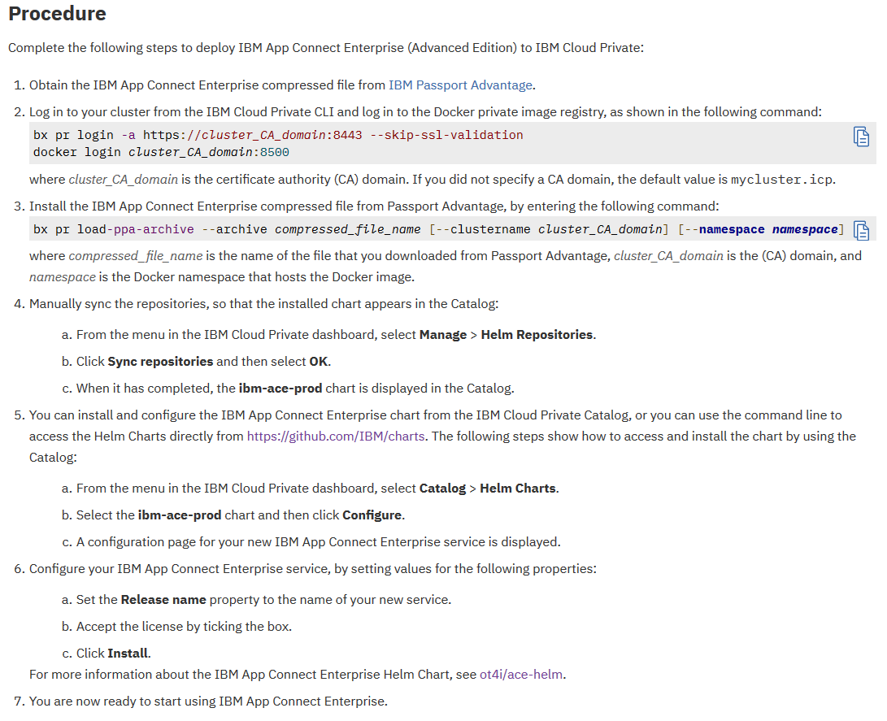
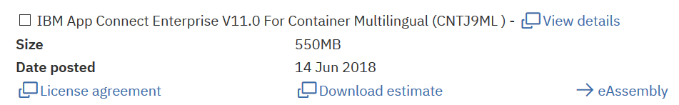
Installing App Connect Enterprise into IBM Cloud Private
Notes:
bx pr login -a https://cluster_CA_domain:8443 --skip-ssl-validation docker login cluster_CA_domain:8500

Slide 9
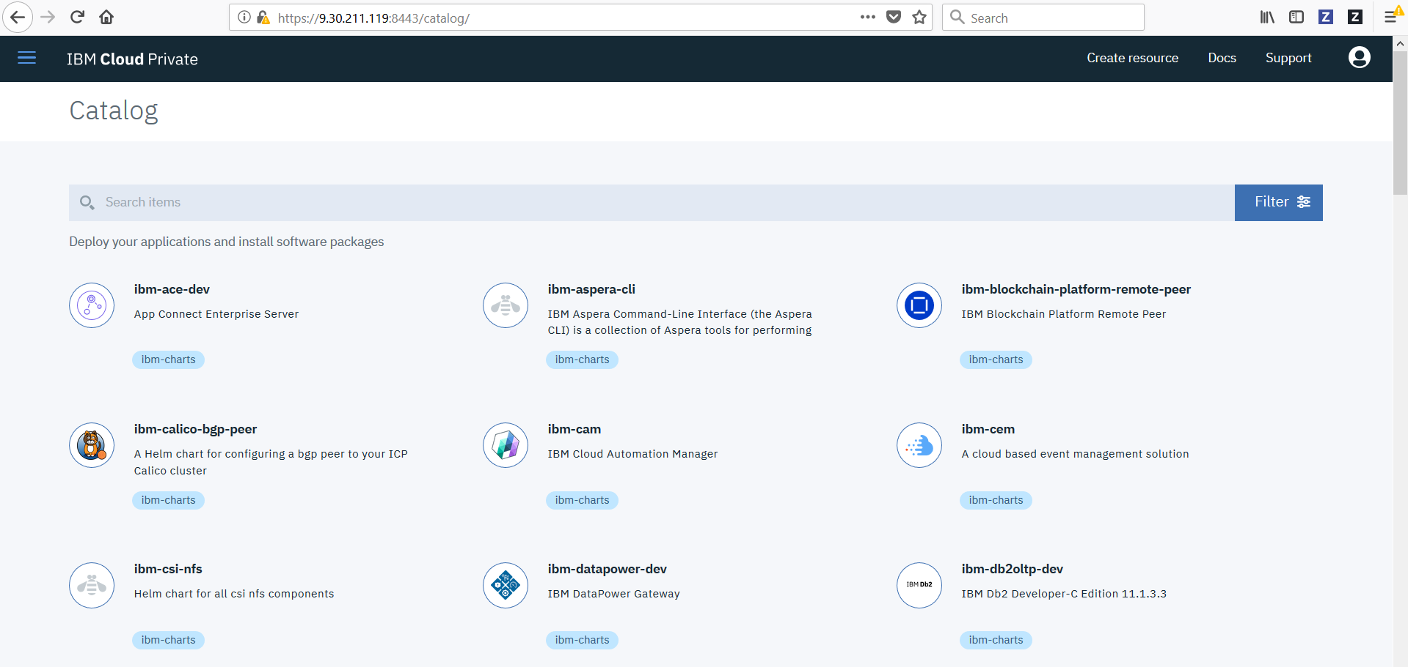
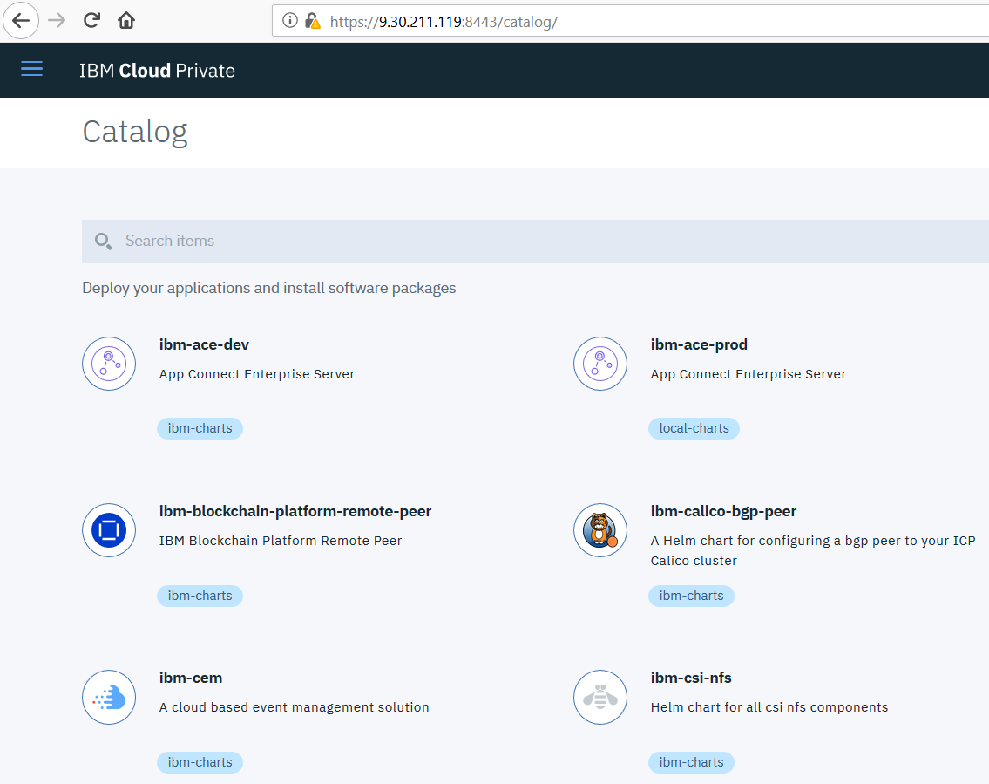
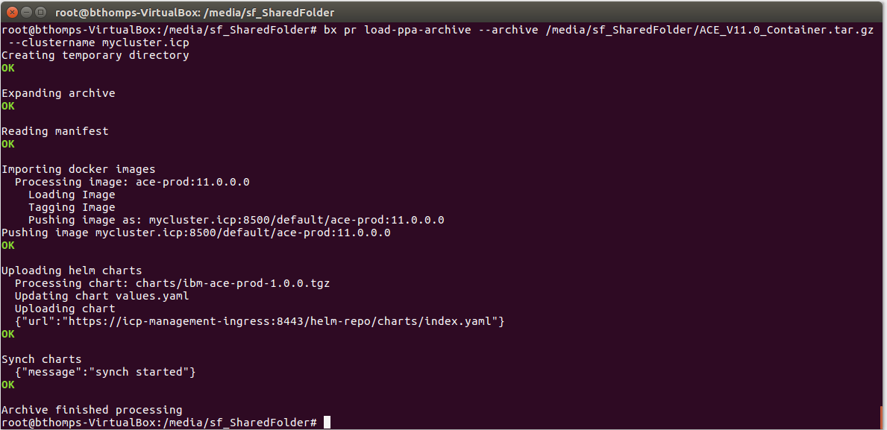

Slide 10
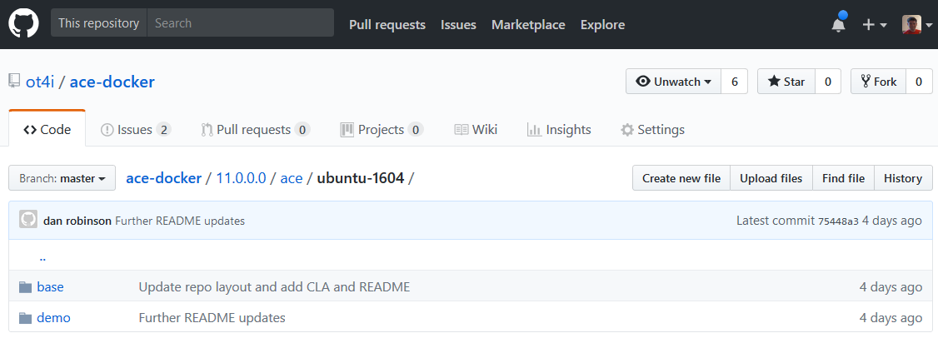
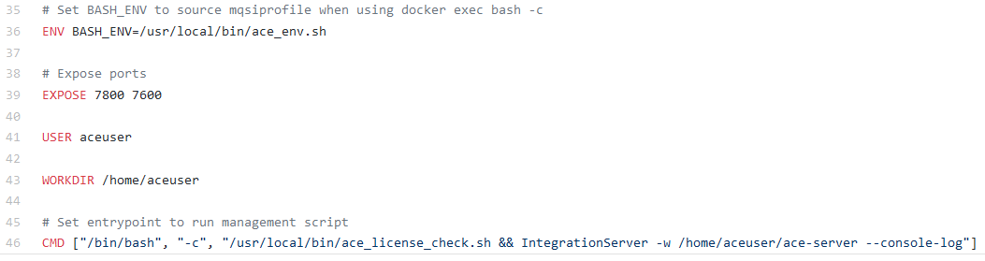

Slide 11
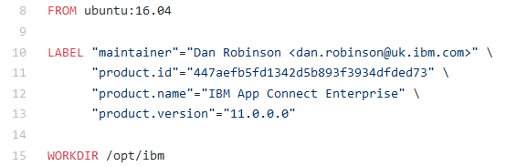
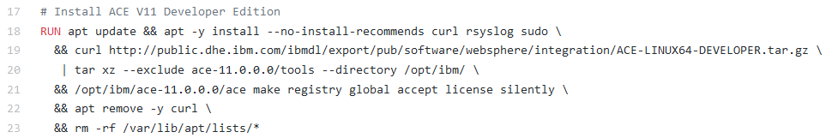
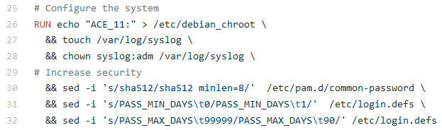
A Quick Look at the ACE Docker file
LABELs identify the built image for ICP purposes
Download ACE installation binaries and unzip them to install
Prepare syslog and set password defaults

Slide 12
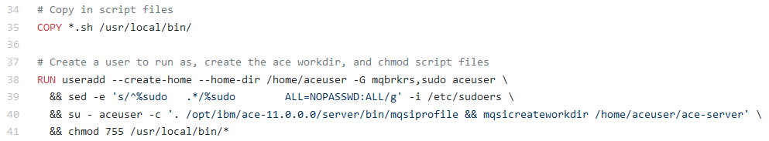
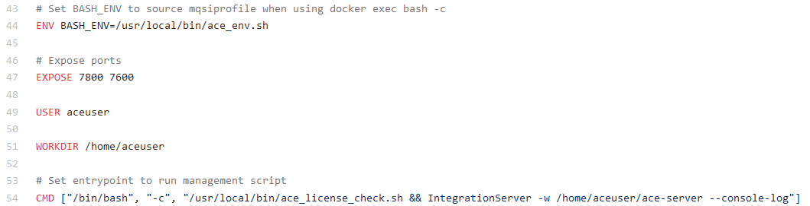
A Quick Look at the ACE Docker file
Create a user and set up a working directory using mqsicreateworkdir
No create and deploy steps are needed … just start up a server pointing at the work directory!

Slide 13
(The next generation of …)
App Connect Enterprise on IBM Cloud Private

Slide 14


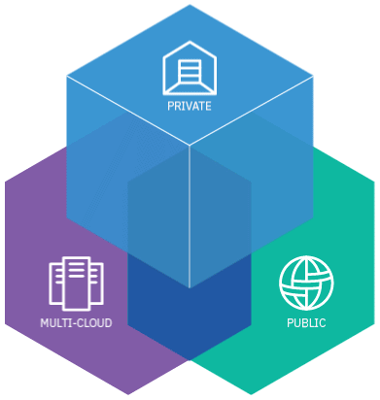
IBM Cloud Paks are Enterprise Ready out of the box
Ad hoc client created containers
IBM provided containers
IBM Cloud Paks on IBM Cloud Private
Client takes software binaries,
Creates their own containers.
Client receives IBM Software
in the form of container(s)
Simplified, Enterprise grade,
Fully supported
IBM Software supported | Depends on product | Yes | Yes
Full stack support by IBM (Base OS, software, deployment on cloud platform) | No | No | Yes
Vulnerability Scanned (Manages image vulnerabilities) | Scan yourself | Yes | Yes
Orchestrated for Production (Built for Kubernetes by product experts) | None | None | Yes
Management and Operations | Roll your own | Roll your own | Built-in
License Metering Integration | Do it yourself | Do it yourself | Yes
Lifecycle Management | Manage it yourself | Manage it yourself | Yes

Slide 15

ReplicaSet: 3 Replicas
ACE Integration Server
ACE on ICP
Control Plane
ReplicaSet: 2 Replicas
ACE Integration Server
Content Server
StatefulSet: 1 Replica
BAR
ACE Integration Server
WMQ Queue Manager
PVC
BAR
BAR
IBM Confidential

Slide 16

ACE on
IBM Cloud Private
Catalog: Helm Charts
Catalog: Images
Ingress Controller
ibm-ace-dashboard
ibm-ace-dashboard
ibm-ace-content-server
Client Application
ibm-ace-server
ibm-ace-icp-configurator
Install using Helm chart ibm-ace-dashboard
ibm-ace
Control Plane
ibm-ace-server
ACE Controller UI
UI Backend
Content Server
Install using Helm chart ibm-ace-server
ACE Server (ibm-ace-server)
Storage
Kibana (Logging)
Grafana (Monitoring)
ELK
Install using Helm chart ibm-ace
Prometheus
ACE Server (ibm-ace-server)
Microclimate UI
Secrets
IBM Microclimate
IBM Confidential

